Slide 1
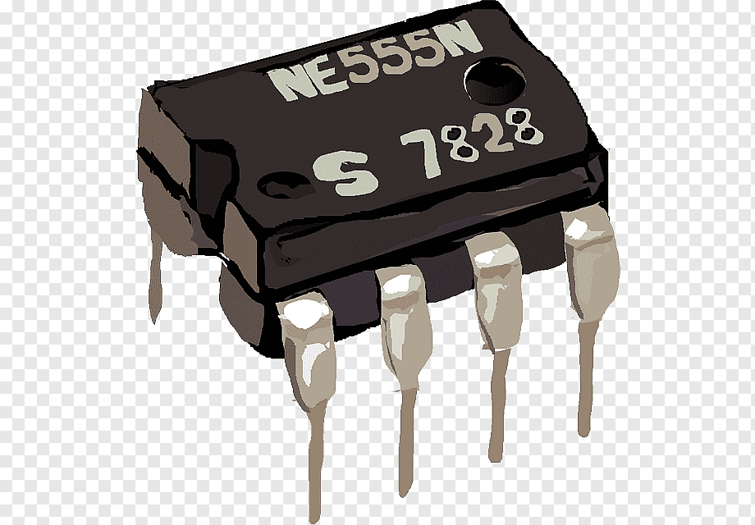
DIGITAL LOGIC & CIRCUITS
FINAL TERM PRESENTATION

Slide 2
555 TIMER
Team members
Rahad-ul-Islam Rabby
20-43644-2
Ridita Zaman Adikta 20-43679-2
Ashiqul Islam
20-4443-2
Nafisa Hossain
20-44090-2
Submitted to:
MR.Bishwajit Banik Pathik
Assistant Professor at American International University-Bangladesh (AIUB)

Slide 3
OUTLINE
Introduction​
Modes of Operation​
Astable Mode​
Operation of Astable Mode​
Mathematical Problem (TH, TL, Frequency)​
Circuit​
555 timer circuit description​
PIN DIAGRAM​
What Is Flash Analog to Digital Converter[ADC]?​
Design of a 5-bit Flash analog to digital converter (ADC)​
Operation of flash Analog to Digital converter​
Mathematical Problem​
Truth table for 5-bit flash diagram​
Flash ADC converter's Advantages & Disadvantaes​

Slide 4
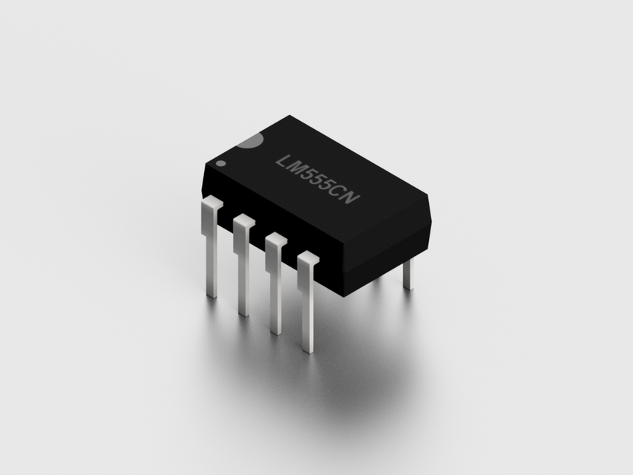
555 TIMER
Designing a LED flasher circuit using IC 555 where LED will be ON for 10s and OFF for 4s until the system is running. Describe mode of operation, Frequency, values of tH and tL. Show the wave shape observed at Pin # 3
RAHAD UL ISLAM RABBY
20-43644-2

Slide 5
Modes of Operation
Astable Mode: In this mode the output of a 555 timer switches between the two unstable states without any external trigger. The feature of the 555 timer can be used to generate continuous rectangular wave. Astable mode works as a oscillator circuit, in which output oscillate at a particular frequency and generate pulses in rectangular wave form.
RAHAD UL ISLAM RABBY
20-43644-2

Slide 6
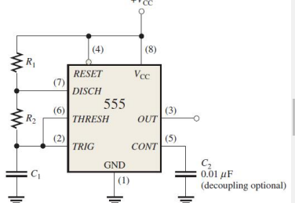
Astable Mode
Astable Mode Schematic: The components which determine the operation are:
• Two resistors (R1 and R2 )
• One capacitor (C1 ) The output of this circuit is a square wave pulse.
RAHAD UL ISLAM RABBY
20-43644-2

Slide 7
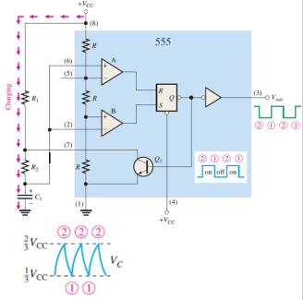
Operation of Astable Mode
• Initially, when the power is just turned on, the capacitor (C1) remain uncharged and thus the trigger (pin 2) and threshold (pin 6) is at 0V. So, output of comparator A is 0 and comparator B is 1. Thus, Q1 is OFF.
• Now, C1 begins charging through R1 and R2, indicated in Figure. When C1 is just below 1/3 VCC, the output of comparator B is 1 and the flip-flop is set. Thus, the output (pin3) is 1.
• The transistor Q1 is OFF.
• When C1 charges beyond 1/3 VCC, then the output of comparator B is 0. However, the output (pin3) is still 1 and the transistor is still OFF.
• So during the charging phase the output (pin3) of the 555 timer remains HIGH.
RAHAD UL ISLAM RABBY
20-43644-2

Slide 8
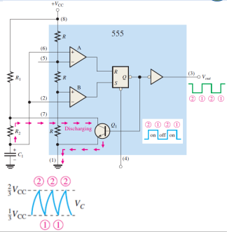
Operation of Astable Mode
• Once the voltage of the C1 is just beyond 2/3 VCC, the output of the comparator A becomes 1.
• This resets the flip-flop. Thus the output (pin3) is 0. However, Q1 turns on and the capacitor starts discharging.
• Once the voltage of C1 is below 2/3 VCC, the output of the comparator A becomes 0. However, the capacitor still discharges. And the output (pin 3) remains 0.
• Therefore, during the discharge phase the output of the 555 time is 0.
• When the capacitor C1 discharges just below 1/3 VCC, the output of the comparator becomes 1 and the flip-flop is again set.
• Thus, again the charging cycle begins.
RAHAD UL ISLAM RABBY
20-43644-2

Slide 9
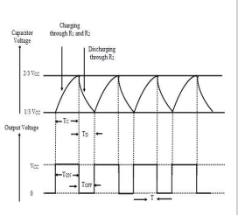
Mathematical Problem (TH, TL, Frequency)
• The capacitor charges through R1 and R2 and during the charging phase the output is HIGH. Thus, time of the HIGH pulse can be calculated as:
TH = 0.693C1 (R1 + R2) = 9.98ms [R1= 8.6KΩ, R2= 5.8KΩ, C1=1uF]
• The capacitor discharges through only R2 and during the discharging phase the output is LOW. Thus time of LOW pulse can be calculated as:
TL = 0.693C1(R2) = 4ms
• The time period of the oscillator is:
T = TH + TL = 0.693C1(R1 + 2R2) = 13.98ms
• Frequency of the oscillator is:
F = 1 /(0.693C1(R1 + 2R2)) = 71.53 Hz
• Duty cycle: D. C. = TH/( TH + TL) = 71.4%
RAHAD UL ISLAM RABBY
20-43644-2

Slide 10
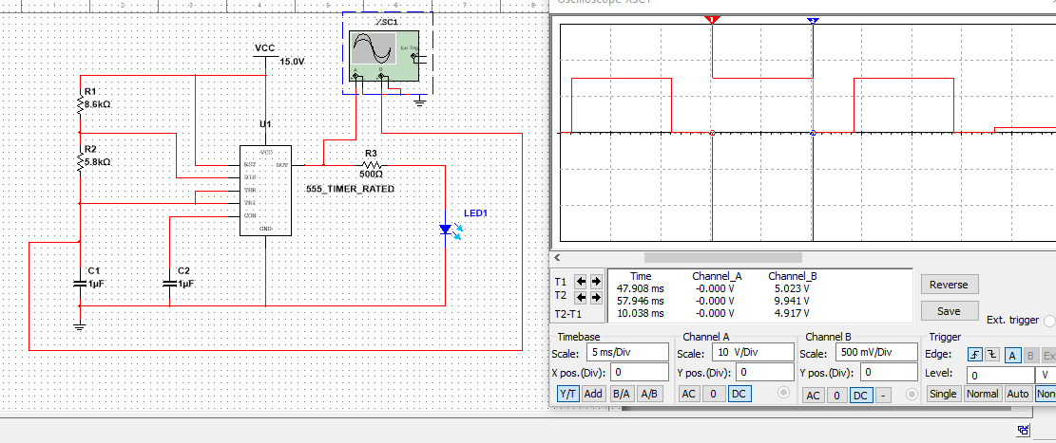
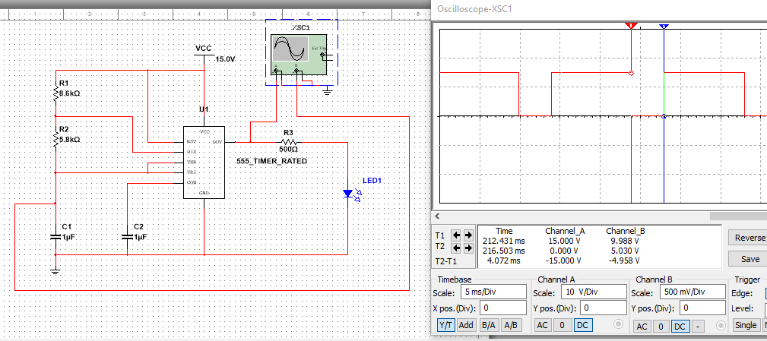
Circuit, Simulation & Simulation value:
T on:
T off:
RAHAD UL ISLAM RABBY
20-43644-2

Slide 11
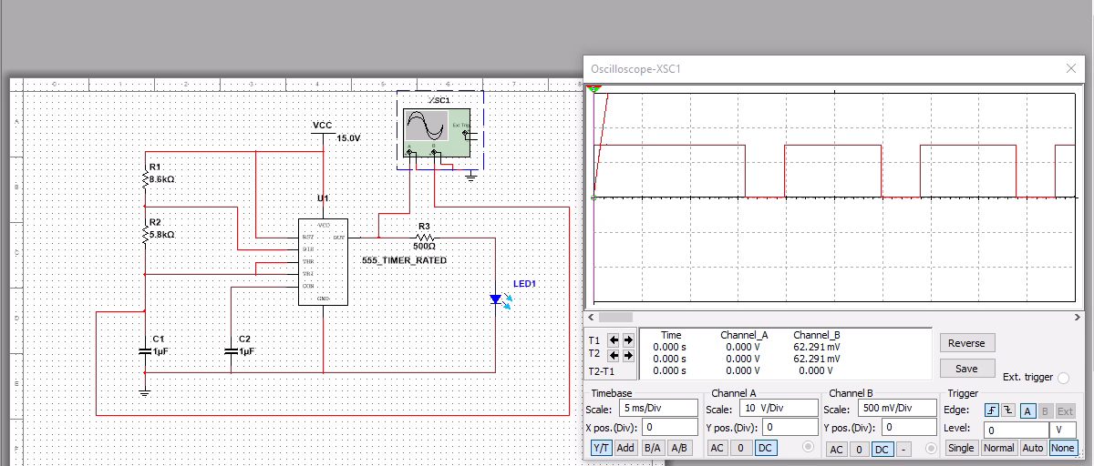
Simulation
RAHAD UL ISLAM RABBY
20-43644-2

Slide 12
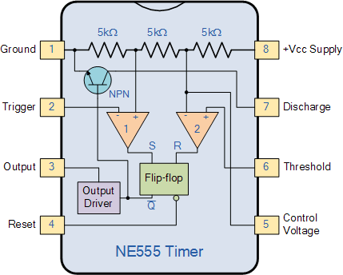
555 timer circuit description
The 555 Timers name comes from the fact that there are three 5kΩ resistors connected internally producing a voltage divider network between the supply voltage at pin 8 and ground at pin 1. The voltage across this series resistive network holds the negative inverting input of comparator two at 2/3Vcc and the positive non-inverting input to comparator one at 1/3Vcc.
Ashiqul Islam
20-44043-2

Slide 13
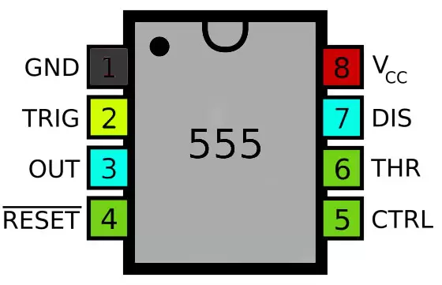
PIN DIAGRAM
PIN 1-Ground​
PIN2- Trigger​
PIN3-Output​
PIN4- Reset​
​PIN5-Control Voltage​
PIN6-Threshold​
PIN7-Discharge​
PIN8-Supply +Vcc​
Ashiqul Islam
20-44043-2

Slide 14
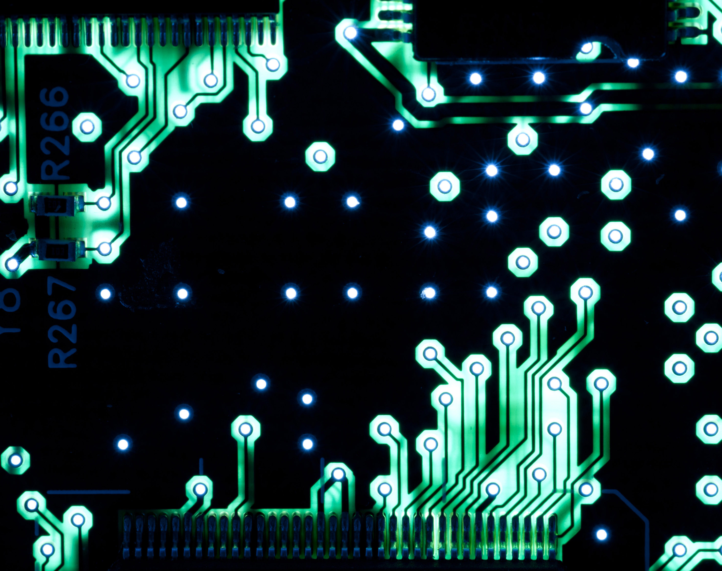
Ridita Zaman Adikta ID:20-43679-2 Group: 555 Timer
Flash Analog To Digital Converter[Flash ADC]
This Photo by Unknown author is licensed under CC BY.

Slide 15
What Is Flash Analog to Digital Converter[ADC]?
A faster converter.
It's ideality
Power consumer.
Bigger than other ADCs.
Limitations.
Ridita Zaman Adikta ID:20-43679-2

Slide 16
Design a 5-bit flash analog to digital converter (ADC) for converting an analog input signal of 10mV. Consider reference voltage of 20 mV, R = 3 kΩ.
We have design 5bit flash ADC by using 2^{n}-1=2⁵-1=31 comparator and 2^{n}=2⁵X5 priority encoder. For analog input 10mv the output of ADC is "10000".
[In general, 2^{n} − 1 comparators are required for conversion to an n-bit binary code. The number of bits used in an ADC is its resolution.]
Ridita Zaman Adikta ID:20-43679-2

Slide 17
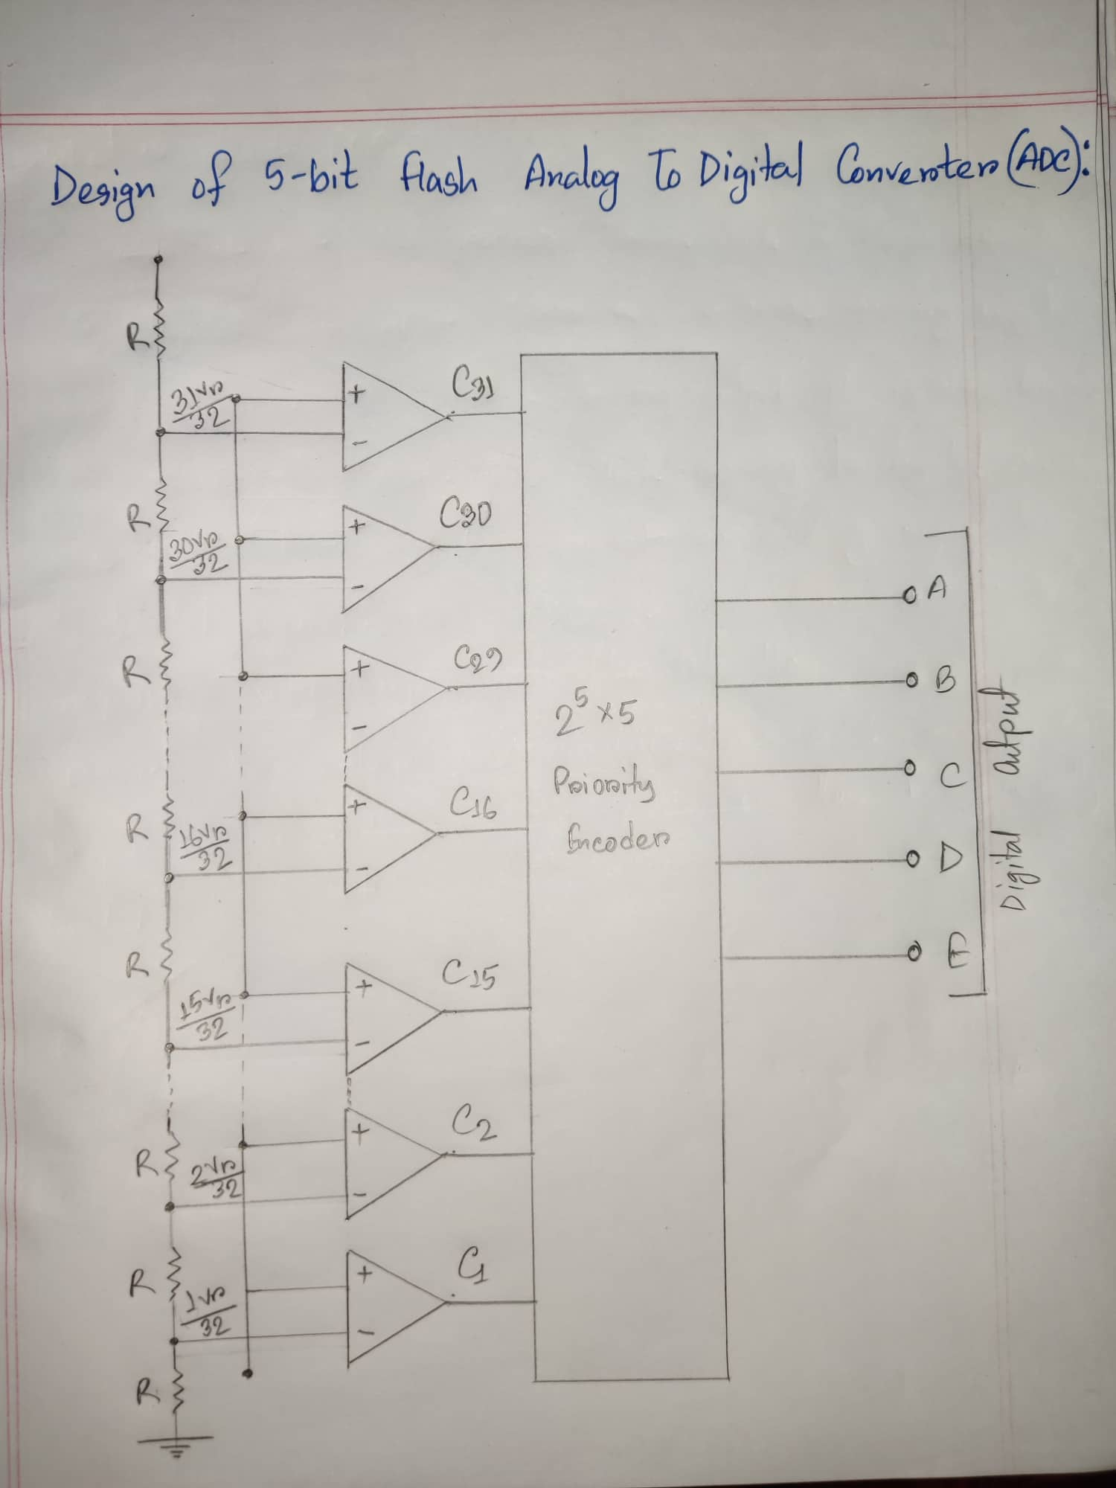
Design of a 5-bit Flash analog to digital converter (ADC)
Ridita Zaman Adikta ID:20-43679-2

Slide 18
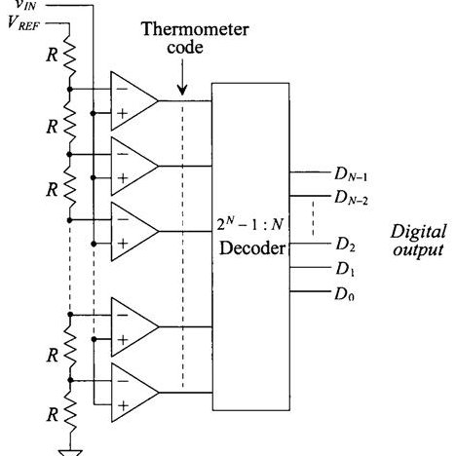
Operation of flash Analog to Digital converter
All the comparator are connected to a priority encoder,which produces a digital output corresponding to the input having highest priority thus the digital output represent the voltage i.e closest in value to the analog input.
Nafisa Hossain
20-44090-2

Slide 19
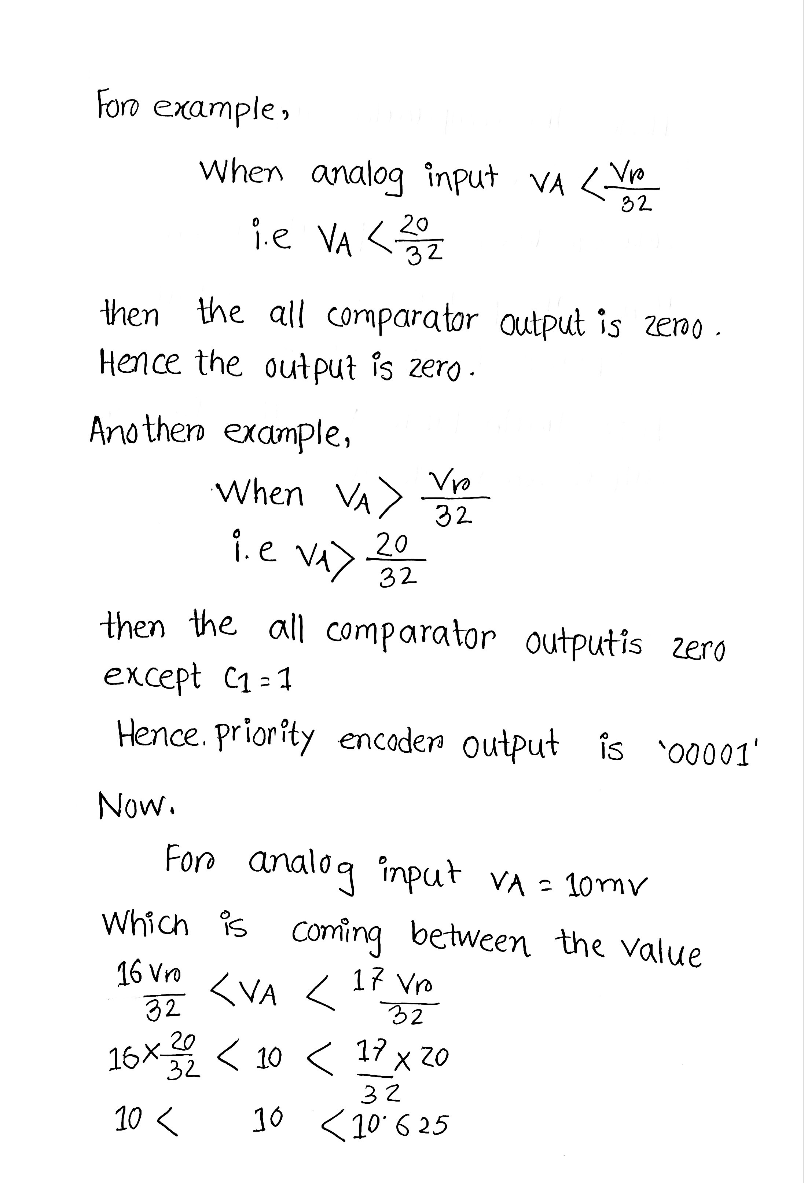
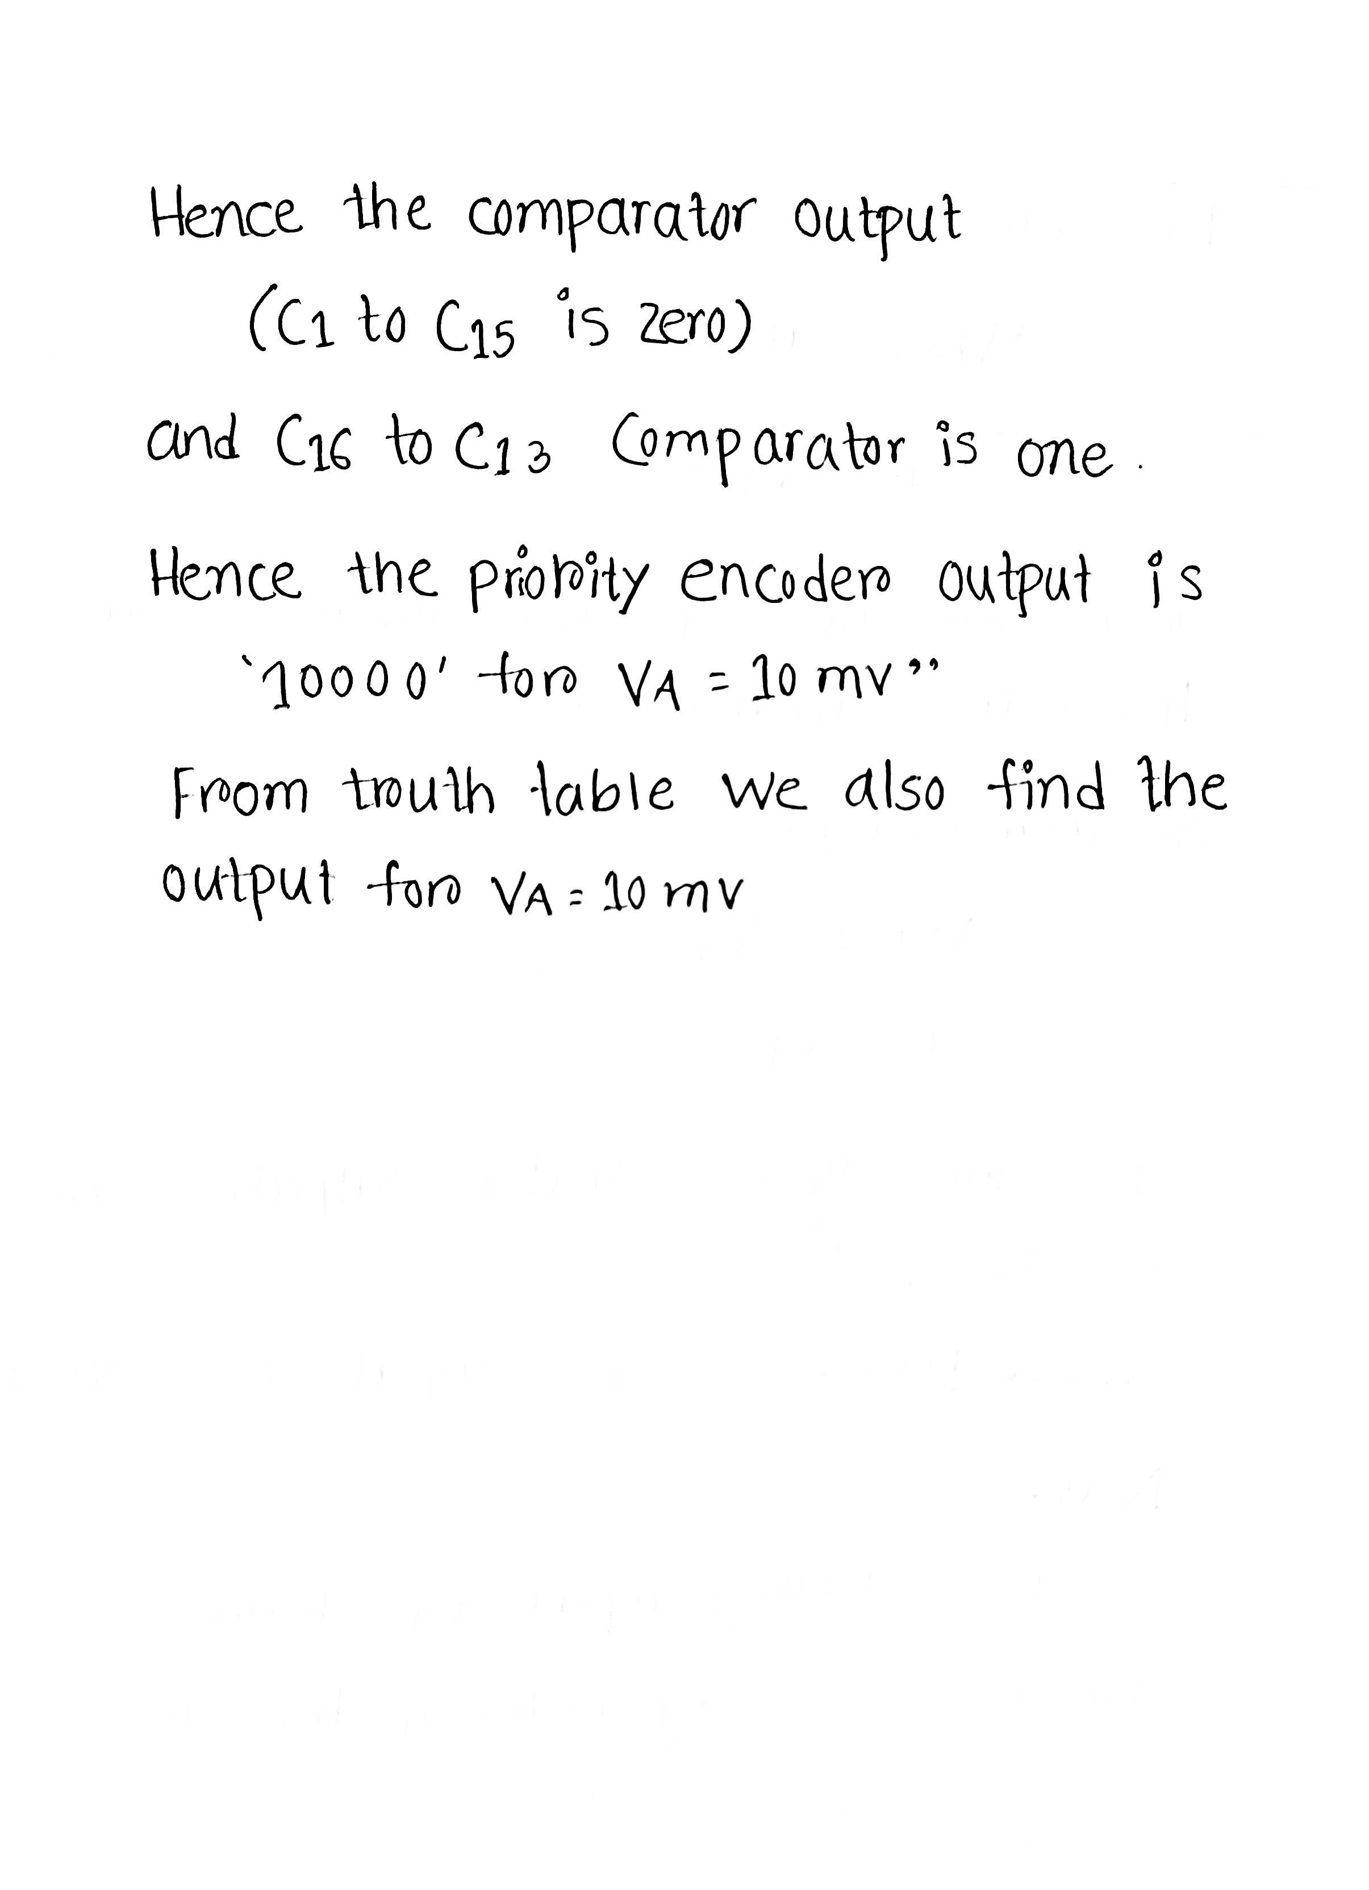
Mathematical Problem
Nafisa Hossain​
20-44090-2​

Slide 20
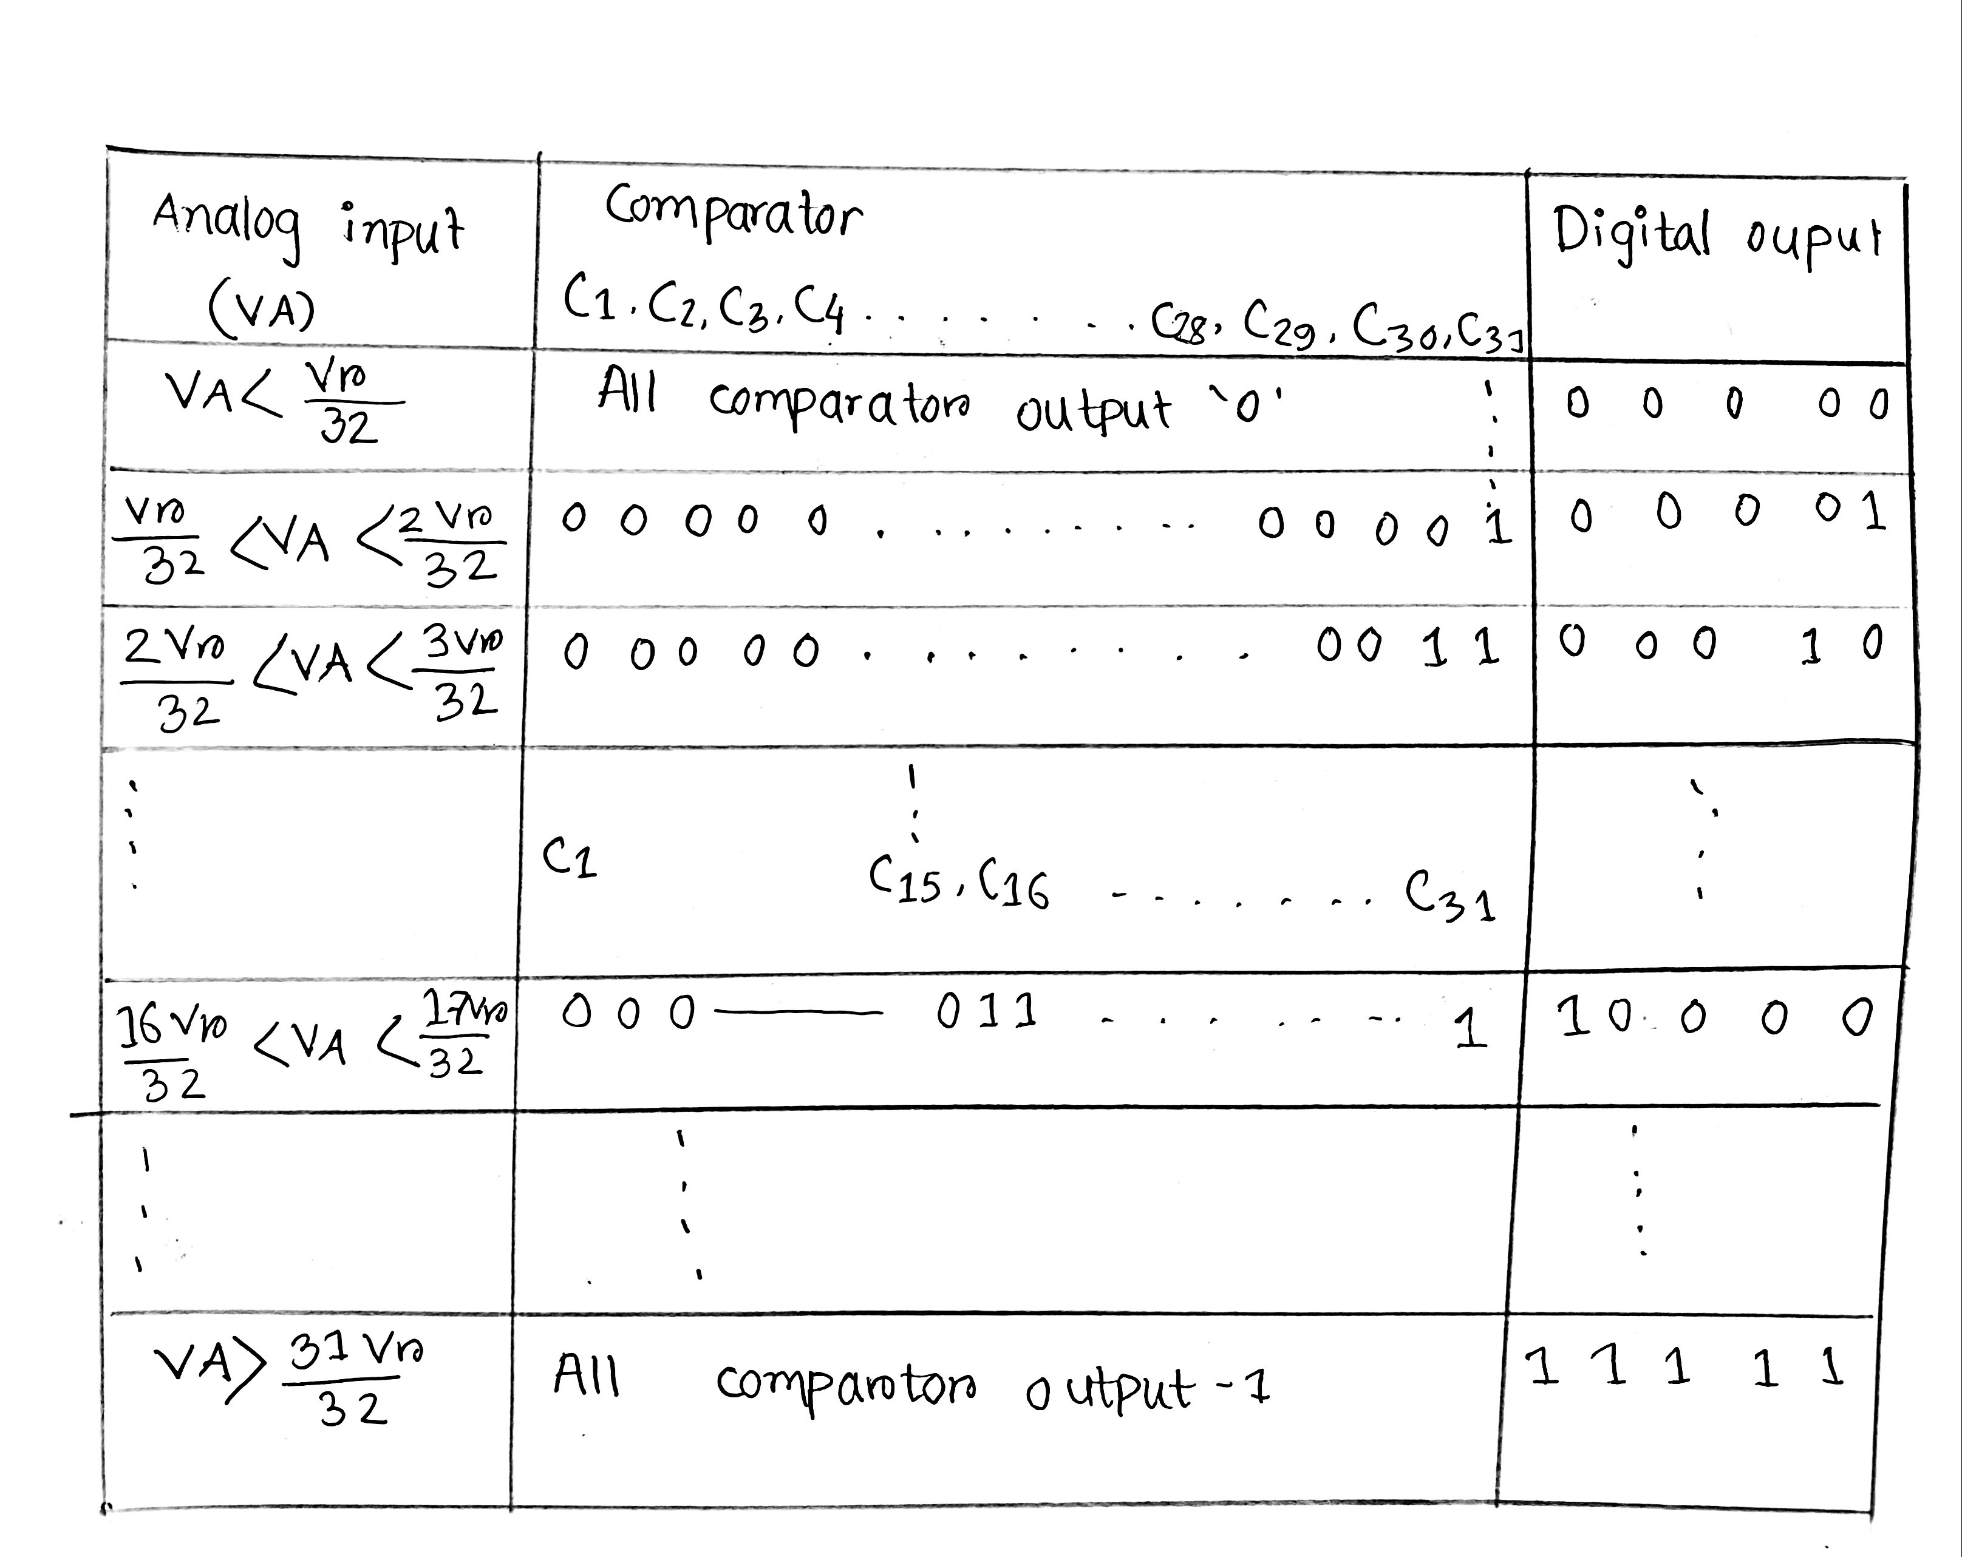
TRUTH TABLE FOR 5-BIT FLASH DIAGRAM
Nafisa Hossain​​
20-44090-2​​

Slide 21
Flash ADC converter's Advantages & Disadvantaes
Advantages-
Fastest (in order of nano seconds)
Simple operationl theory
Disadvantages-
Limited resolution
Power consuming
Nafisa Hossain​​​
20-44090-2​​​

Slide 22

THANK YOU!
This Photo by Unknown author is licensed under CC BY-SA.

